Slide 1

Database Vulnerabilities
Overview & Solutions
(Database Management Systems for Security)

Slide 2

Our Team Members
SENEVIRATHNE T.K. – IT20052942
GUNATHILAKA S.B.M.B.S.A. – IT20028046
ARACHCHI T.A.D.L.P.T. – IT20122164
DASUNDI P.D.S. – IT20129330

Slide 3
Vulnerability(Computing)
3

Slide 4
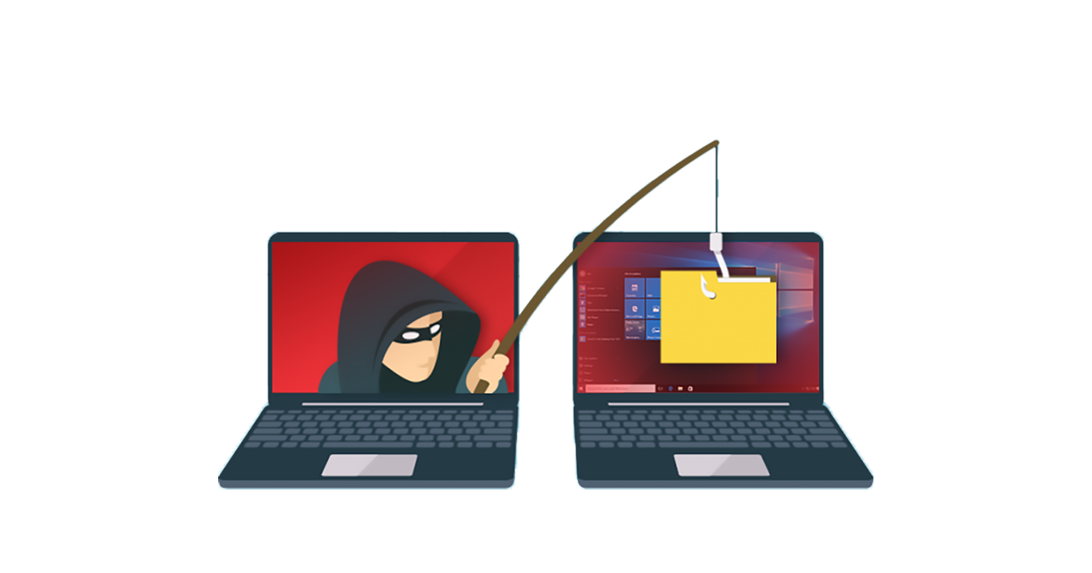
Vulnerability
Vulnerability is a flaw or weakness in a system or network that could be exploited to allow an attacker to manipulate the system or cause damage or spectating our system. We can define a vulnerability in cybersecurity, a vulnerability is a weakness or some problem that can be exploited by an attacker to gain unauthorized access to perform an unauthorized action on a computer system.
According to the attackers, vulnerability is a weakness or some problem that can be exploited by an attacker to gain unauthorized access into the computer system.
SENEVIRATHNE T.K. – IT20052942
4

Slide 5
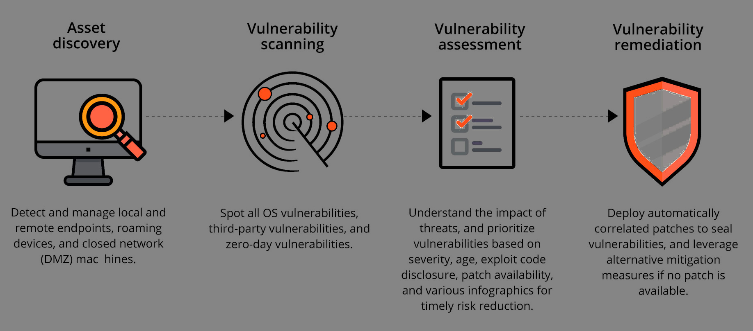
Vulnerability Of System Resources
A flaw or weaknesses in a system’s design, implementation, or operation and management that could be exploited to violate the system’s security policy.
When the resource is corrupted → Violate Integrity
When the resource is leaky → Violate Confidentiality
When the resource is unavailable → Violate Availability
SENEVIRATHNE T.K. – IT20052942
5

Slide 6
Database Vulnerability
6

Slide 7

Database Vulnerability
In database security, vulnerability is the result of an attempt to gathering or exploiting information through all known security flaws in a system.
SENEVIRATHNE T.K. – IT20052942
7

Slide 8
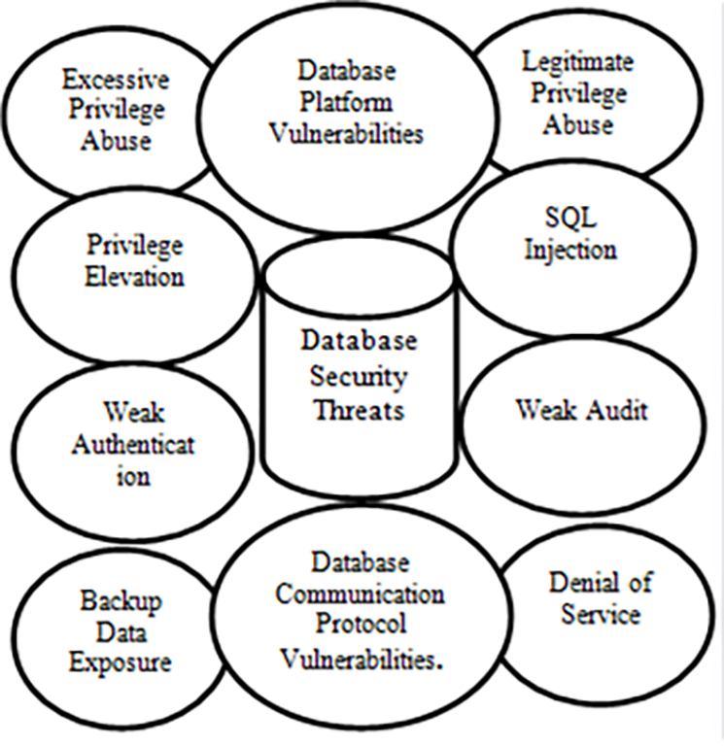
An exploited vulnerability can allow an attacker to run a piece of code to access a victim’s system, steal or destroy data and install malware to do exploitation the attacker must be able to connect to the victim’s database server.
Vulnerability can be exploited by an attacker using a variety of methods.
SQL injection
Buffer overflows
Excessive privilege abuse
Legitimate privilege abuse
Privilege elevation
Exploitation of vulnerable, misconfigured databases
Denial of service
Database communication protocol vulnerabilities
Unauthorized copies of sensitive data
Backup data exposures
SENEVIRATHNE T.K. – IT20052942
8

Slide 9
SQL Injection(SQLi)
9

Slide 10
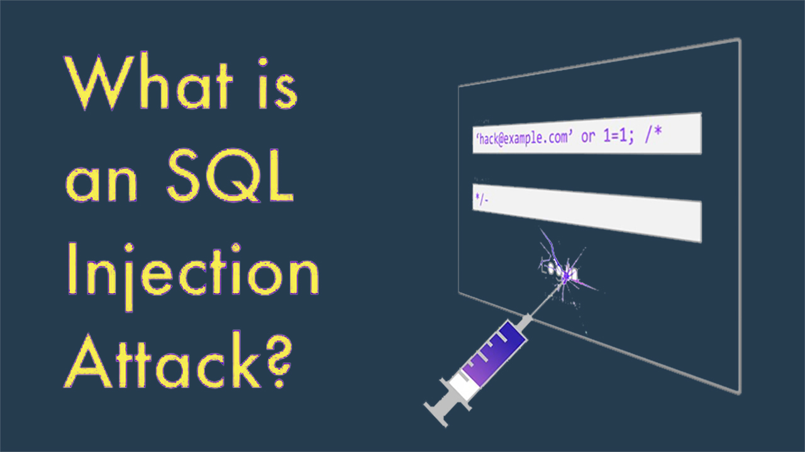
10

Slide 11
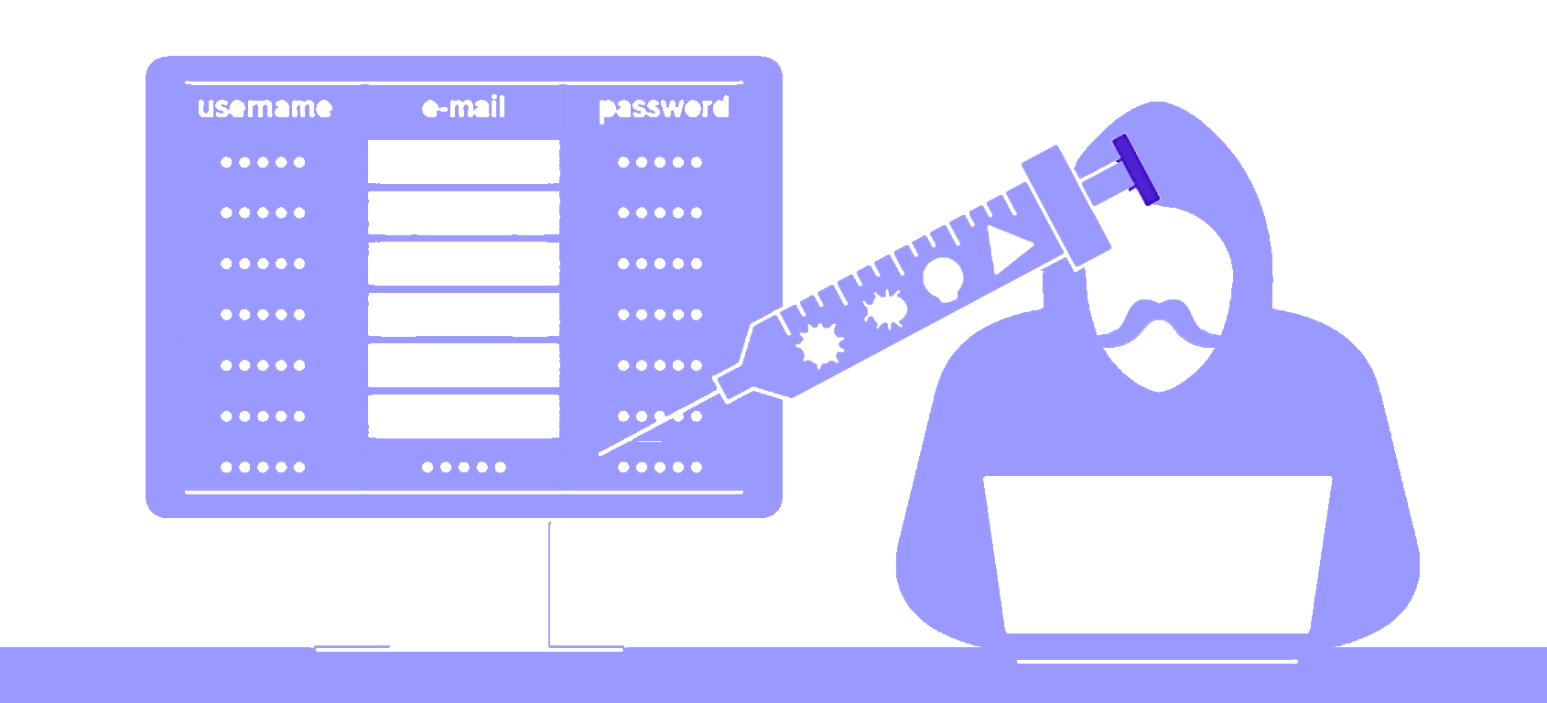
SQL injection(SQLi)
SQLi is the most common and most dangerous web hacking method.
It uses malicious SQL code of websites and web apps for back-end database manipulation to access, process, and delete information from the database.
A SQL injection is consisting of the injection of a SQL query using input data from the client-side to the application. if the SQL injection is successful, it can read sensitive data like usernames and passwords from the database or it can modify the database or destroy the database
SENEVIRATHNE T.K. – IT20052942
11

Slide 12
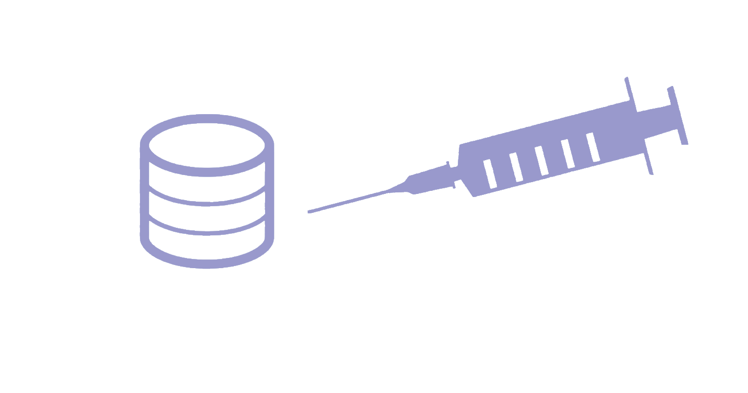
SQL Attack Works
SQLi attacks use insecurities in the code at the point of access to a database.
When SQLi attacks are successful, attackers can :
Logging into front end without password
Access, Modify, and delete stored data from the databases.
Information access and disclosure
Can do a lot of harmful things or changes in the database
GUNATHILAKA S.B.M.B.S.A. – IT20028046
12

Slide 13
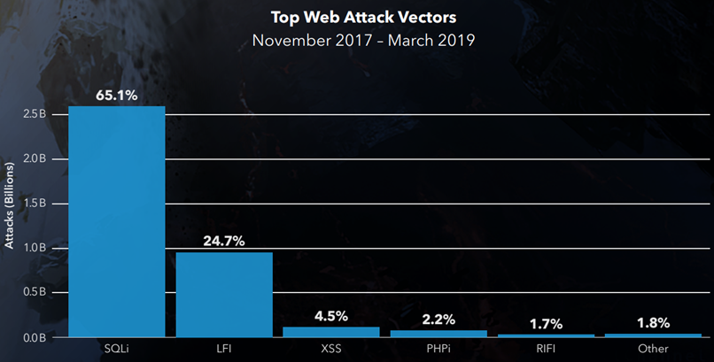
Other injection attacks comparing with the SQLi attack (according to SANREN CSC )
GUNATHILAKA S.B.M.B.S.A. – IT20028046
13

Slide 14
There are many kinds of vulnerabilities, attack methods, and techniques. Some common SQL injections are given :
Retrieving hidden data
Subverting application logic
UNION attacks
Examining the database
Blind SQL injection
As the first step attacker do analysis about the victim server and collect some information and find a vulnerability.
Attacker collects some input data to code the malicious SQL query.
After the attacker sends the payload to the server the malicious query triggers inside the database
GUNATHILAKA S.B.M.B.S.A. – IT20028046
14

Slide 15
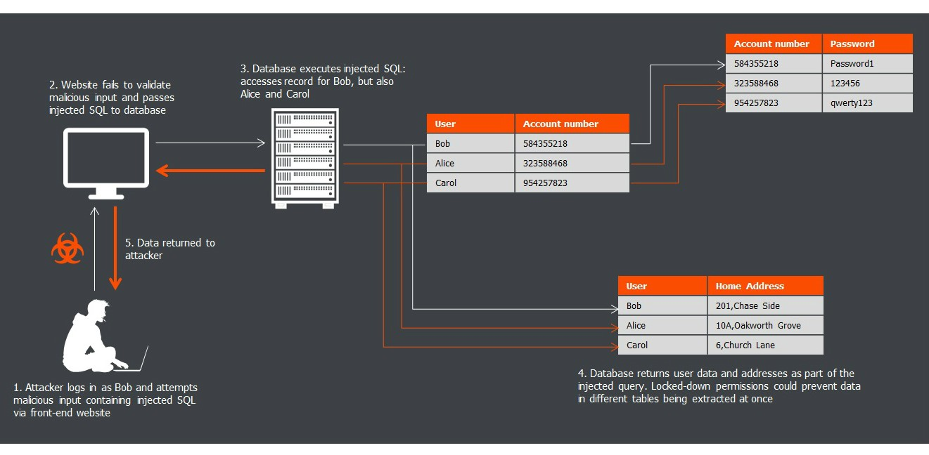
GUNATHILAKA S.B.M.B.S.A. – IT20028046
15

Slide 16
SQLI Prevention & Mitigation
Preventing or mitigating the risk of SQL injection is not easy, but can take some steps to protect the structural database :
Discover vulnerabilities
Repair vulnerabilities
Remediate vulnerabilities
Mitigate vulnerabilities
The prevention techniques depend on the type of SQL vulnerability, the database engine, and the programming language.
DASUNDI P.D.S. – IT20129330
16

Slide 17
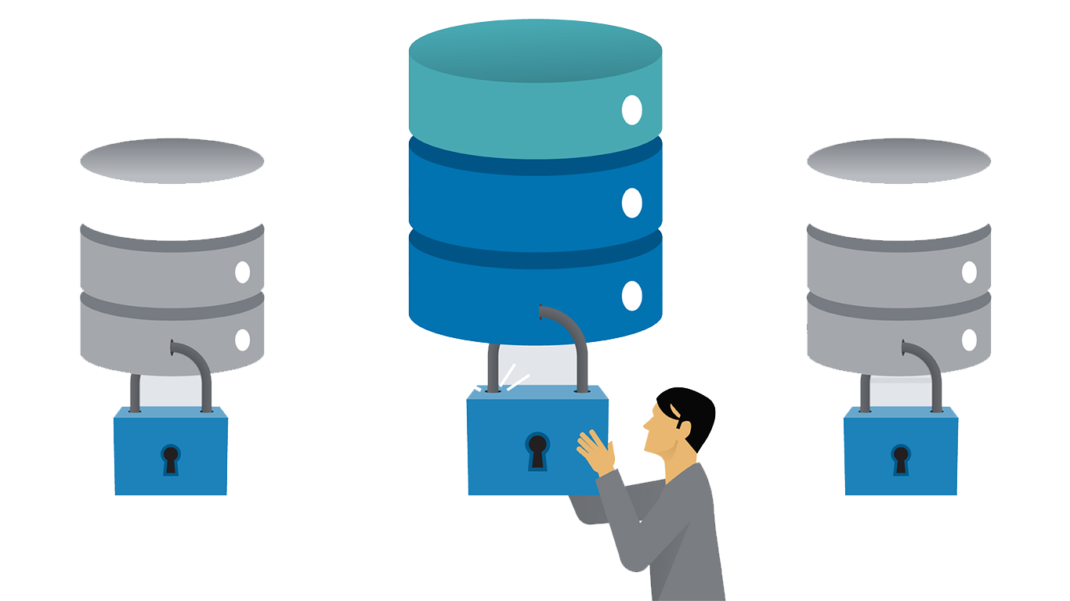
There are several effective actions to prevent SQLI attacks :
Validate User inputs
Limit Read-Access
Encryption: Keep your secrets
No Shared Databases or User Accounts
Employ verified mechanisms
Code Development and Buying better software
The prevention techniques depend on the type of SQL vulnerability, the database engine, and the programming language.
DASUNDI P.D.S. – IT20129330
17

Slide 18
SQLI Countermeasures
Disable all extra and unused features that you do not use. because that inactive features could be potentially dangerous for our database.
Put a custom error message, SQL error messages give so much information to an attacker.
Enable escape functions. that allows you to secure our database server against most attacks.
Use technologies like AMNESIA, SQL Check, SQL Guard, and CANDID.
Use SQL rand, That converts the instruction-set randomization application to the SQL language and a random number added to the result. then the attacker unable to guess the supplement number.
Prohibit keywords and characters that the user does not have to enter a SQL query. If this kind of keyword is returned it is mandatory to remove it, because it can come from an attack.
ARACHCHI T.A.D.L.P.T. – IT20122164
18

Slide 19
Buffer Overflow
19

Slide 20
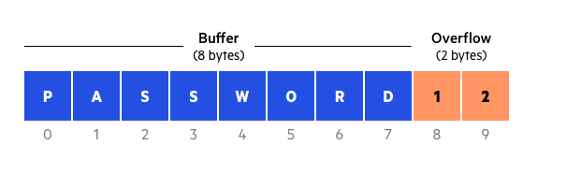
Buffer Overflow
A buffer overflow (known as buffer overrun) is a piece of software coding used by an attacker to gain unauthorized access to a system.
This kind of vulnerability occurs when we give a program too much data. the overflowed excess data corrupts nearby memory space and replaces or changes other data.
After corrupting nearby data the program will behaves differently. this kind of vulnerability is also called buffer overflow or buffer overrun.
SENEVIRATHNE T.K. – IT20052942
20

Slide 21

For example when we pouring coffee into a cup more than its maximum volume the coffee will overflow to the outside. the same thing happens when we put data into a buffer more than its maximum capacity the excess data overflows to nearby memory locations. because that the program related to that overflowed buffer will be crash. this is known as buffer overflow.
Types of Buffer Overflow Attacks :
Stack overflow attacks
heap overflow attacks
GUNATHILAKA S.B.M.B.S.A. – IT20028046
21

Slide 22
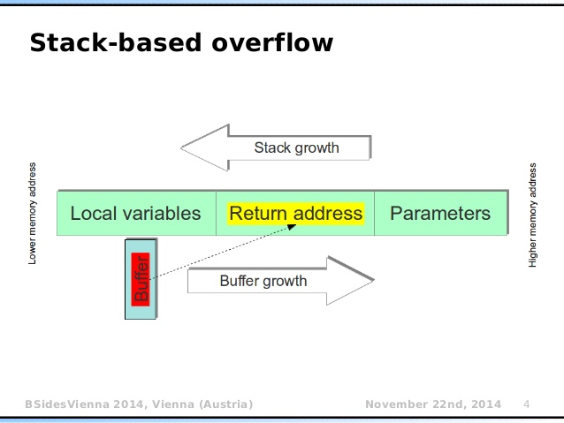
Stack Overflow Attack
GUNATHILAKA S.B.M.B.S.A. – IT20028046
22

Slide 23
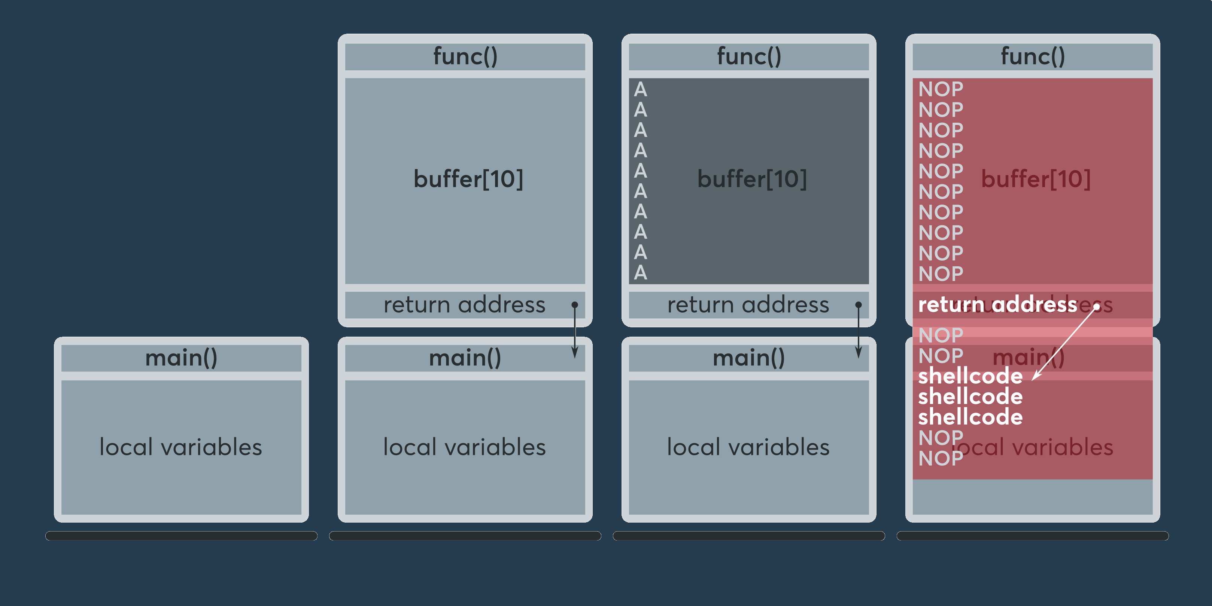
Stack Buffer Overflow
Program start
func () call
Legitimate data
Buffer overflow
GUNATHILAKA S.B.M.B.S.A. – IT20028046
23

Slide 24
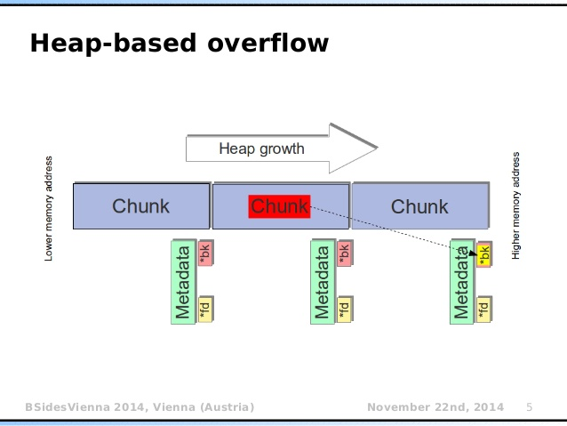
2. Heap buffer overflow
GUNATHILAKA S.B.M.B.S.A. – IT20028046
24

Slide 25
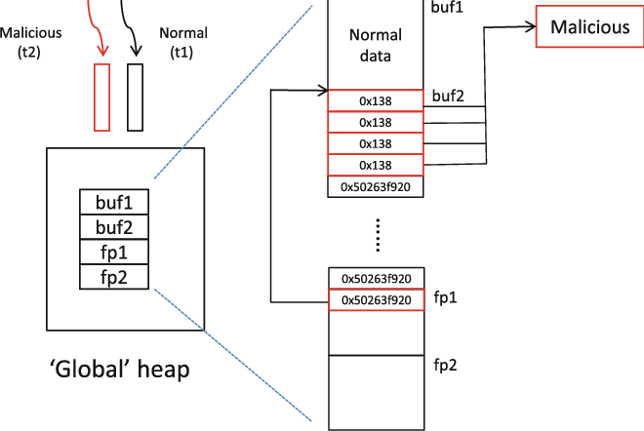
GUNATHILAKA S.B.M.B.S.A. – IT20028046
25

Slide 26
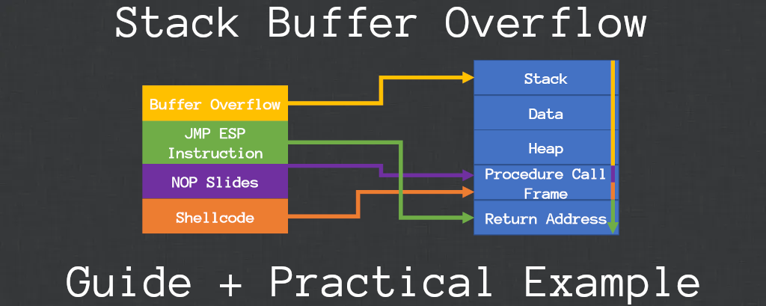
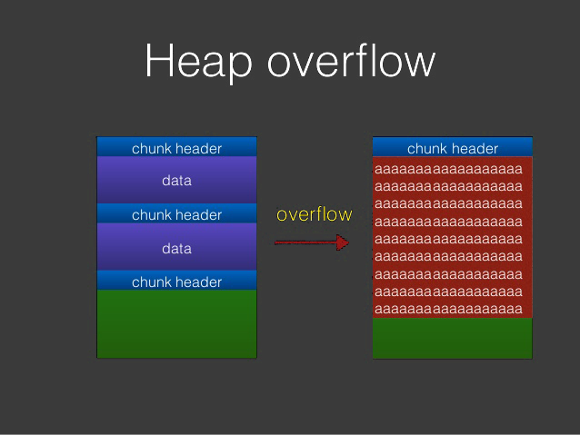
GUNATHILAKA S.B.M.B.S.A. – IT20028046
26

Slide 27
Buffer Overflow Works
Stack memory usually keeps empty until the program gets inputs. after the stack receives inputs, the program writes a return memory address and puts the inputs on it.
When the stack operations end, the program sends the inputs to another memory address . A program develops by its author he set some space for the stack.
There is a chance to occur a stack overflow when inputs and the input stack mismatch or consist memory more than the program allocated memory.
The security of the program is can be attacked by the mismatch inputs . When a stack overflow attack performs by an attacker and he set the return address point to malicious code. because that the program will be crashed.
The program tries to go to the return address and fix it but the attacker already changed the address.
GUNATHILAKA S.B.M.B.S.A. – IT20028046
27

Slide 28

When the correct address is required, the NOP instructions begin to execute on both sides. the new address set by the attacker is inside the padding then the malicious codes will be executed.
To do this attacker needs high-level permissions to implement the attack. so the program runs with permissions from the attacker’s account or kernel.
The commands found at the modified return address set by the attacker runs by the stack overflow, the program thinks it is still running. now the command prompt has enough permissions it means the attacker achieved control of the OS.
GUNATHILAKA S.B.M.B.S.A. – IT20028046
28

Slide 29
Buffer Overflow Prevention & Mitigation
As a security solution in modern operating systems has runtime protections to help mitigate buffer overflow attacks.
There are some other techniques we can use to mitigate this kind of attack.
Address space randomization
Data execution prevention
Make sure to up to date with vendor-issued patches and updates
Writing secure code
Marking areas of memory as either executable or nonexecutable with Data Execution Prevention
Manually testing for buffer overflows
When possible, always use programming language that doesn’t allow buffer overflow attacks
ex- java, python, .NET
DASUNDI P.D.S. – IT20129330
29

Slide 30
Buffer Overflow Countermeasures
Commonly countermeasures are classified into the following methods we can use those to prevent buffer overflow attacks :
Disable unnecessary services in the system.
Checking the source code for vulnerability function.
Turn on other access control methods like TCP wrappers, that can authenticate who is going to log into the system with strong passwords. But don’t enable just access controls with an IP address or a hostname. That can easily be compromised.
Always try to keep the system updated with the latest security patches released by the vendor.
Use more secure coding methods and secure functions when developing a program or database.
Set up dynamic runtime checks.it can restrict an attack coming from an attacker.
Try to use better string libraries.
Ex-libsafe.h
Strlcpy
ARACHCHI T.A.D.L.P.T. – IT20122164
30

Slide 31
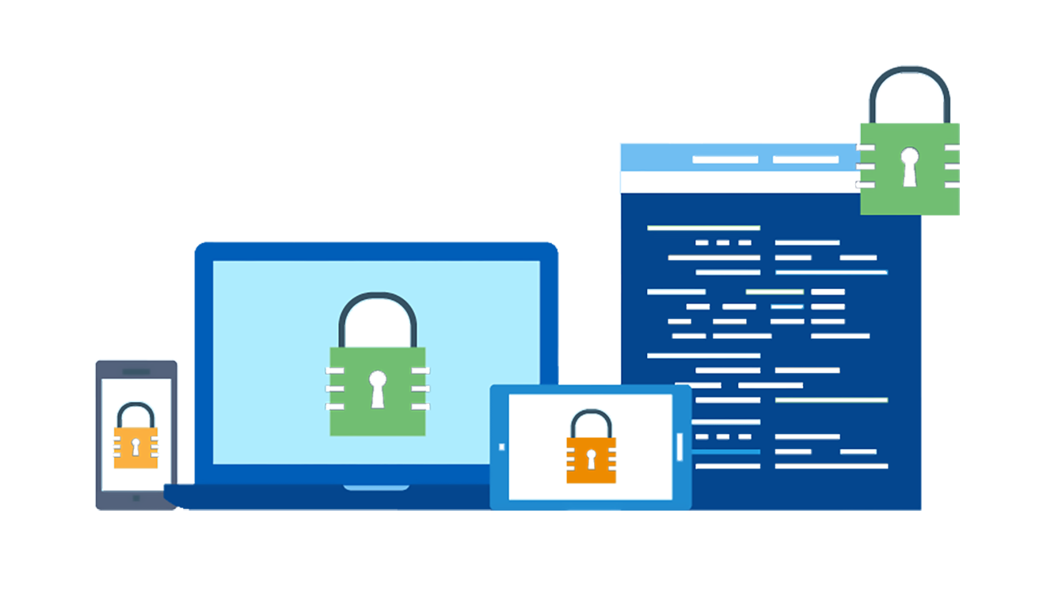
For further security we can use technologies like pointgaurd, ssp (ProPolice's Stack Smashing Protection, stackshield)
Protect your Linux systems using a firewall or a host-based intrusion prevention system.
Keep always, sure your systems are updated with the latest kernel and security patches.
ARACHCHI T.A.D.L.P.T. – IT20122164
31

Slide 32
Thank You!
32

